Slide 1
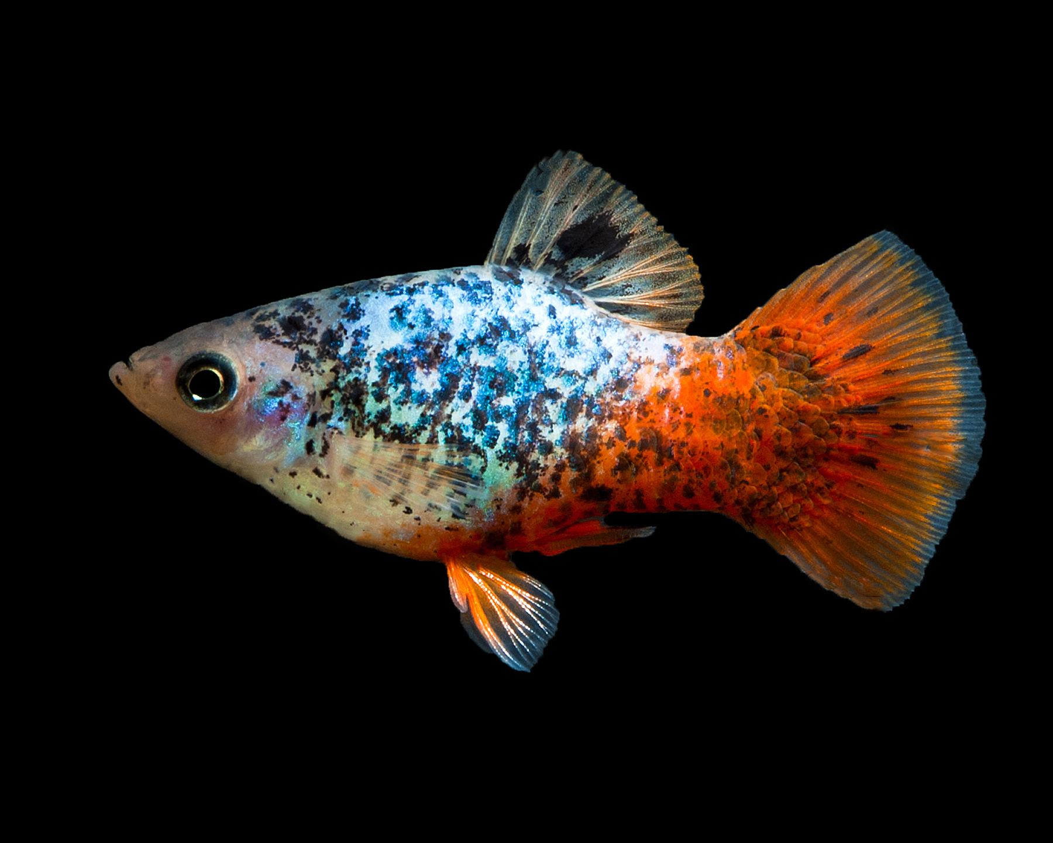
platy
The platy is a freshwater fish.
It is native to the Americas.
It is a member of the minnow family.

